Slide 1
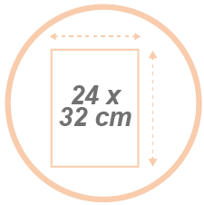
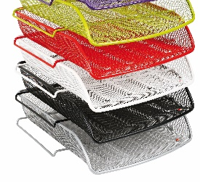
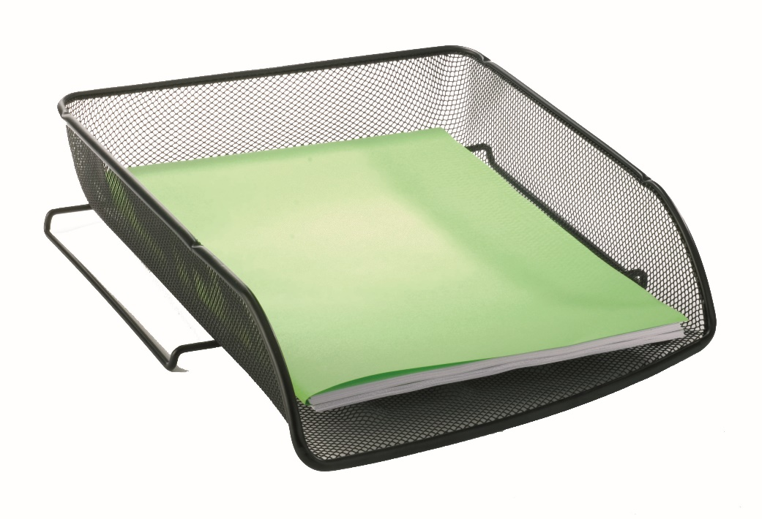
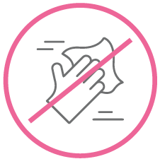

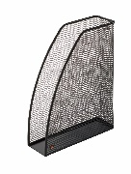
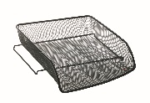


MESHFRA N Letter tray - A4
Energise and organise your office with this metal Mesh letter tray.
For A4 documents (24 x 32 cm) in portrait orientation.
Practical, possibility of stacking the baskets
Easy to clean thanks to its wired structure
Belongs to a complete range of
20 Mesh metal accessories
…
The French-style letter tray is elegant, solid and functional. Made of metal Mesh, the basket is ultra resistant and will hold A4 size documents (24 x 32 cm).
Plus, benefit from a complete range of desk accessories to harmonise your workstation.

Slide 2

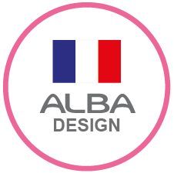

MESHFRA N Letter tray - A4
Energise and organise your office with this metal Mesh letter tray.

