Slide 1

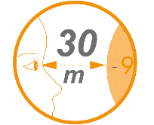
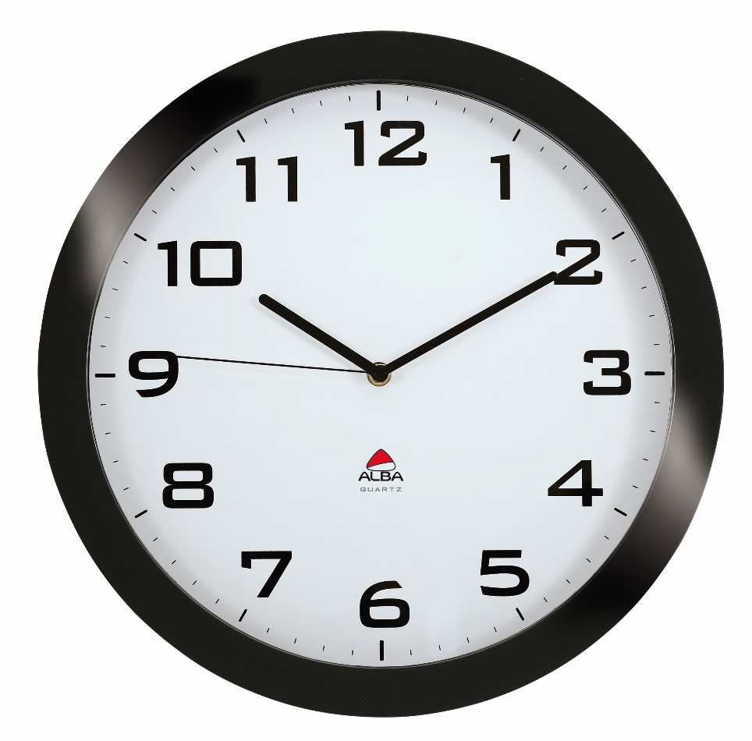


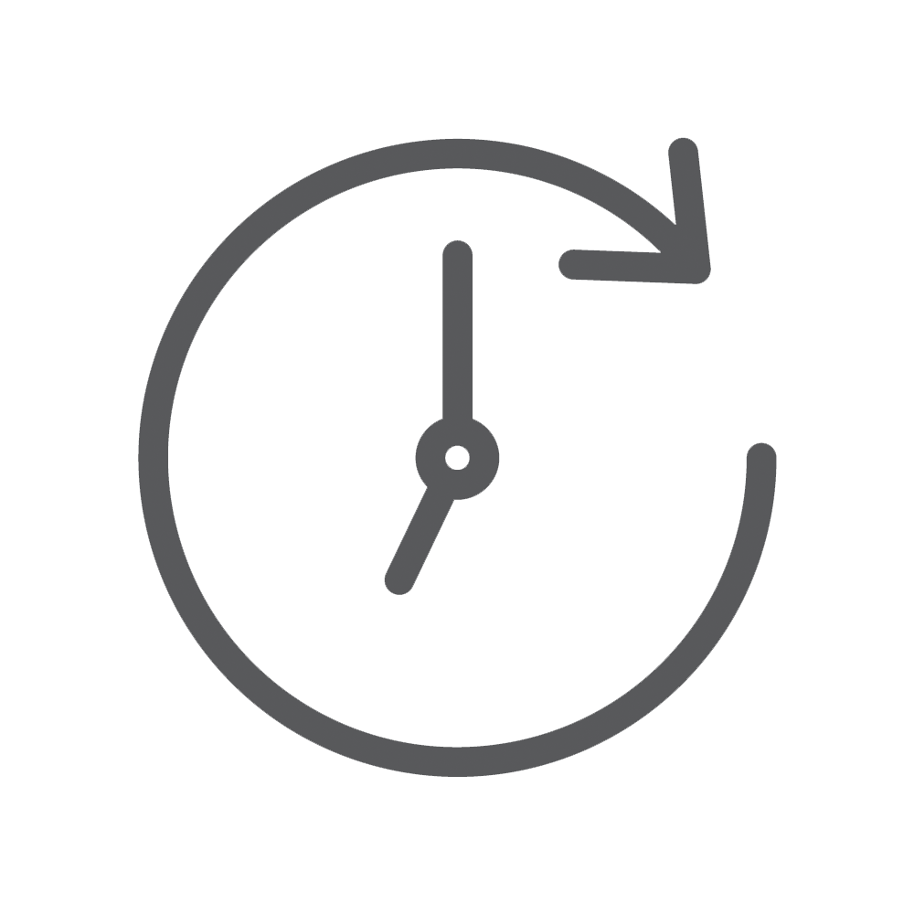

HORISSIMO Silent clock with perfect time visibility
Choose this silent wall clock with its elegant and timeless style
Excellent time visibility up to 30m
Black figures on white background
(Diameter 38 cm - Number 2,5 cm)
High precision & silent
quartz movement
Works with a battery
LR6/AA (not supplied)
Combining style and elegance, this clock will perfectly fit in all your workspaces. Key feature : a silent and precise movement to work in the best conditions
Be always on time with the HORISSIMO wall clock. Practical and aesthetic, this wall clock will give personality to your workspace and rhythm to the life of your company. It has an ABS black frame and a glass lens, a silent a precise quartz mechanism, a white face with large black figures and 3 hands.

Slide 2





HORISSIMO Silent clock with perfect time visibility
Choose this silent wall clock with its elegant and timeless style

