Slide 1
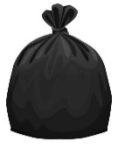
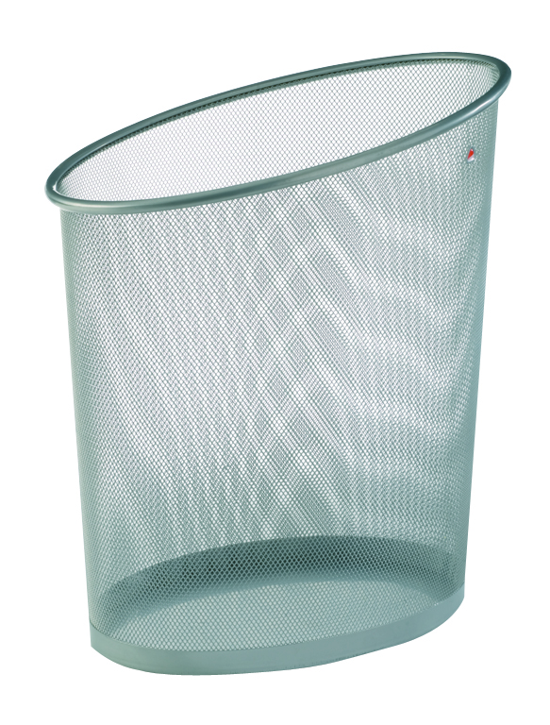
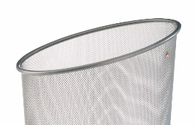

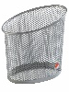
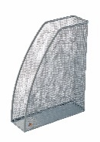
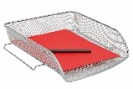


MESHCORB M Metal wastepaper basket - 18 L - 20 L bag
Boost your office with this metal Mesh wastepaper basket.
Large 18 litre capacity and 20 litre bin liners.
20 L
Space-saving thanks to its elliptical shape.
Easy to clean thanks to its wired structure
Belongs to a complete range of
20 Mesh metal accessories
…
Boost your office with this metal Mesh wastepaper basket. Elegant and sturdy, it can easily be placed under your desk. Available in several colours, there is sure to be a wastepaper basket to suit your taste.
Plus, benefit from a complete range of desk accessories to harmonise your workstation.

Slide 2
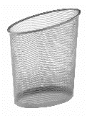


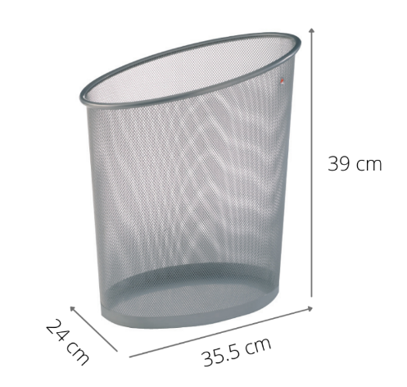

MESHCORB M Metal wastepaper basket - 18 L - 20 L bag
Boost your office with this metal Mesh wastepaper basket.
20 L
18 L

