Slide 1

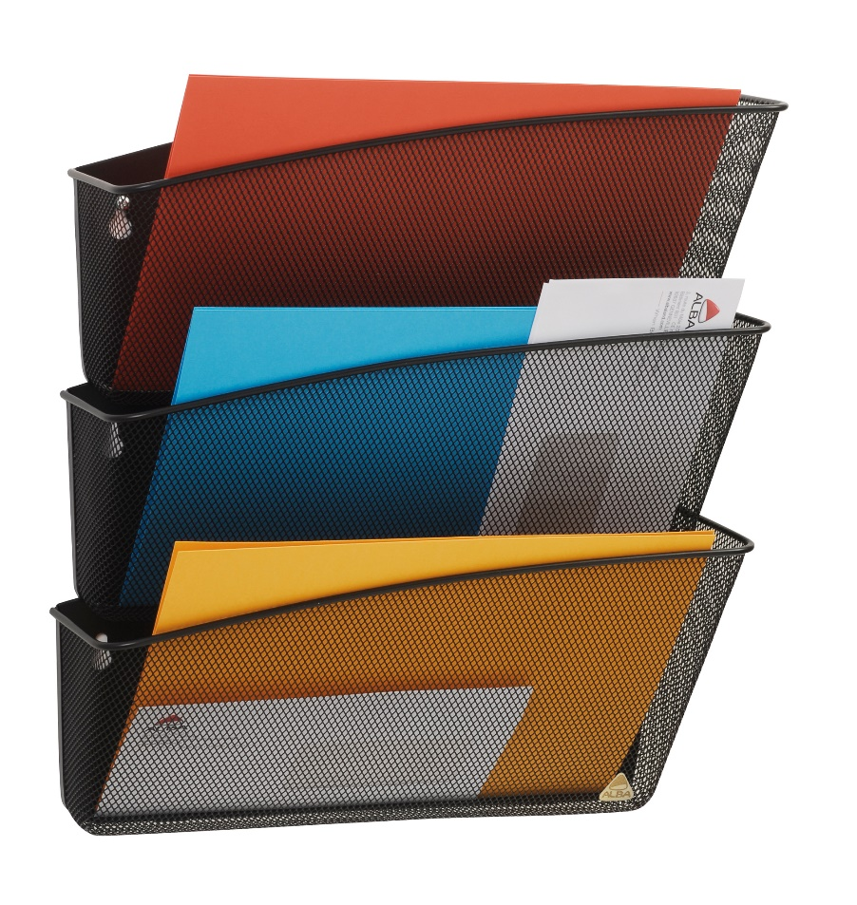
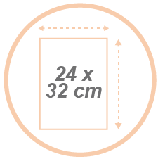


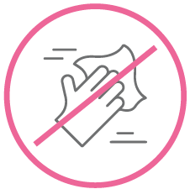

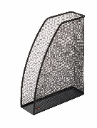
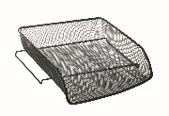


MESHFILE N Set of 3 black wall baskets - A4
Made of metal mesh, the wall-mounted baskets are ultra-resistant and will hold A4 size documents.
Immediate document identification
thanks to its metal mesh structure.
For A4 documents (24 x 32 cm) in landscape orientation.
Can be stacked as a unit.
Easy to maintain thanks to its wired structure.
Part of a complete range of
of mesh desk accessories.
The set of 3 Meshfile wall baskets is elegant, solid and functional. Made of Mesh metal, the wall-mounted baskets are ultra-resistant and will hold A4 size documents. They can be fixed to the wall and are stackable.
An ideal product to organize your office, practical and easy to maintain. Plus, get a full range of desk accessories to harmonize your workstation.

Slide 2


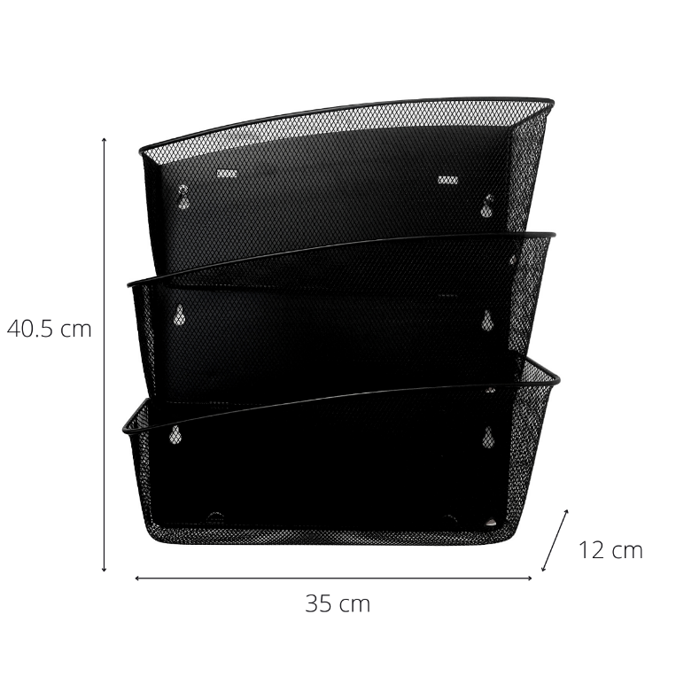

MESHFILE N Set of 3 black wall baskets - A4
Made of metal mesh, the wall-mounted baskets are ultra-resistant and will hold A4 size documents.

