Slide 1
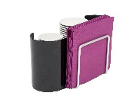
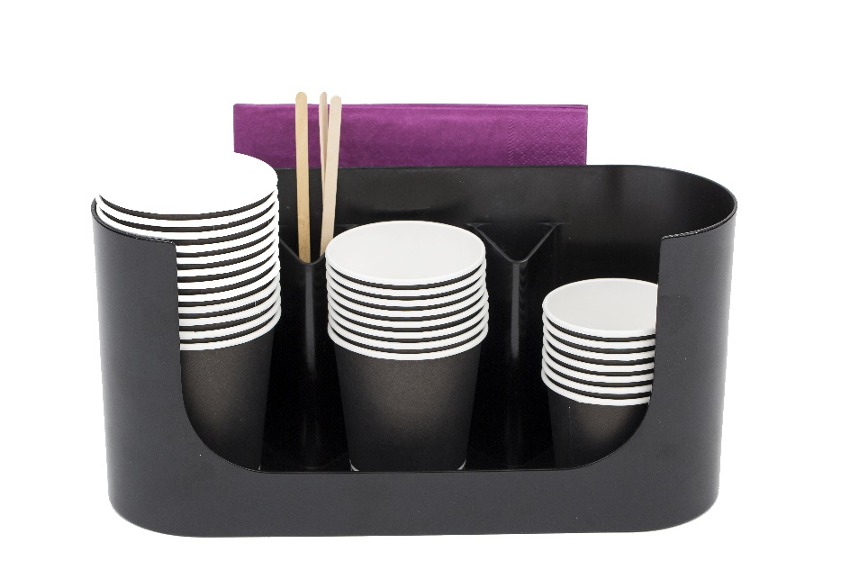
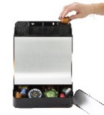
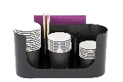
RDVCUP Cup – spoon and napkin holder
Storage space for cups, stirrers and napkins, ready for use.
3 compartments for cups (up to ⌀ 8.5 cm),
2 for stirrers and
a passage at the back for napkins.
This coffee-break accessory belongs to the
Rendez-vous range, entirely dedicated to coffee breaks.
Ideal next to the coffee machine, the Cup Holder keeps cups for your drinks close at hand. It is also practical for storing and distributing napkins and swizzle sticks. It is the coffee accessory that will contribute to a warm reception area in your company.
What's more, you can match it to a whole range of coffee and tea breaks, to meet your practical and aesthetic needs.

Slide 2
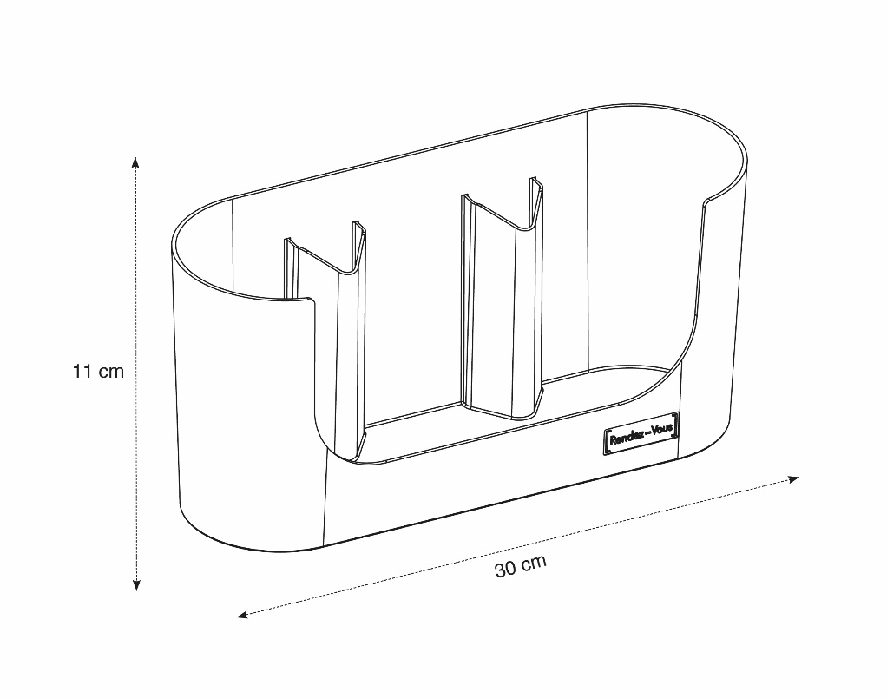
RDVCUP Cup – spoon and napkin holder
Storage space for cups, stirrers and napkins, ready for use.
2ans
WARRANTY

