Slide 1
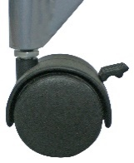
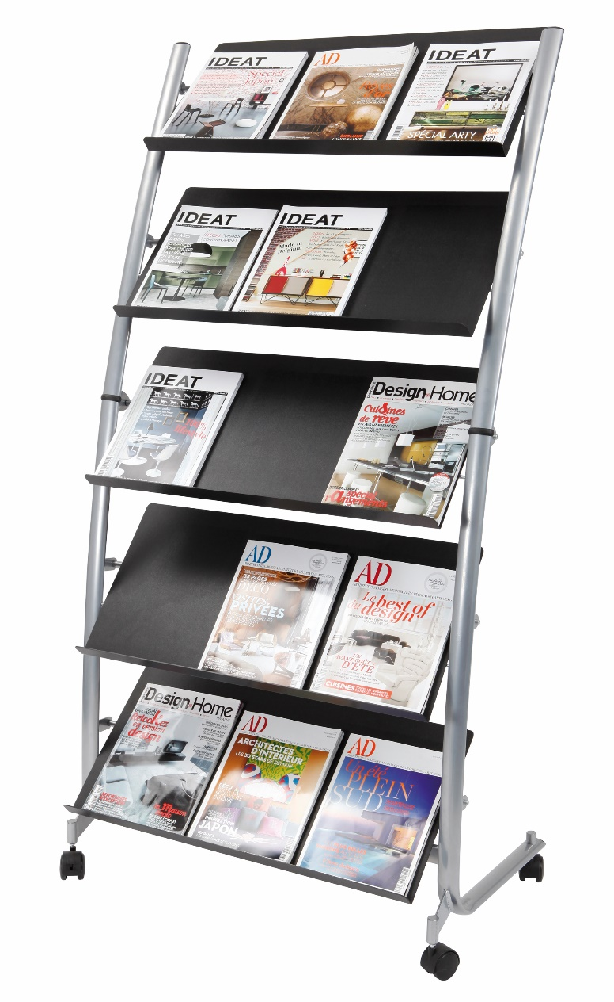
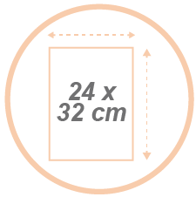
DD5GM Mobile display large model
Elegant and practical mobile display with 5 shelves
Perfect mobility thanks to its 4 casters
5 Shelf for 15 A4 document
(24 x 32 cm)
(Thickness 3 cm)
Easy to see contents
Quick and easy assembly system
(Fixing kit supplied)
Small packaging improvement for
less CO2 emissions
Thanks to its perfect mobility, you can move this display stand wherever you want without difficulty. Its large capacity allows you to exhibit without limits.
The DD5GM display is the ideal accessory for displaying magazines or brochures in your lobby. Practical, you will be able to display your A4 documents in 5 compartments, with 3 documents per shelf you have a total exhibition space of 15 documents.

Slide 2
DD5GM Mobile display large model
Elegant and practical mobile display with 5 shelves

